Slide 1

Introduction to the Accessibility Requirements Tool (ART)
CSUN Assistive Technology Conference | March 2024

Slide 2

Today’s Agenda
What is Section 508?
Why Accessibility Matters
Your Role in Section 508 Requirements
ART Enhancements & Demo
Questions?

Slide 3

What is Section 508?
Notes:
Section 508 of the Rehabilitation Act of 1973 is a federal Law that states Information Technology. In 1998, Congress amended the 1973 Rehabilitation Act to include Information Communication Technology to include people with disabilities. The amended law strengthened Section 508, by establishing accessibility standards and requiring agencies to make their information and communication technology (ICT) accessible to people with disabilities by ensuring that the ICT meets the standards. This includes things like software as a service, web-sites, systems, hardware, keyboards, kios and one of my favorites is electronic documents. It applies to all Federal agencies when they develop, procure, maintain or use information communication technology (ICT).
In 2017 the 508 Standards were revised, like Chapters 1 and 2 (Appendix A), along with Chapters 3 through 7 (Appendix C), contain scoping and technical requirements for information and communication technology (ICT) to ensure accessibility and usability by individuals with disabilities. Compliance with these standards is mandatory for Federal agencies subject to Section 508 of the Rehabilitation Act of 1973, as amended (29 U.S.C. 794d).
Why do you think electronic documents is my favorite to mention when it comes to contracting?
Next slide

Slide 4




Why Accessibility Matters
Remediation
Modification
Deliverables
Lawsuits
Notes:
Why does Accessibility Matter? - It is all of our responsibility to ensure 508 requirements make it into our requirements for Information Communication Technology (ICT). The compliance with Section 508 falls primarily on the ordering level CO/CORs/PM’s. However I want to stress that it is everyone’s responsibility to ensure that any products/services are compliant. The other reasons 508 matters is because it is practical, reduces your workload, saves the government money, and is just the right thing to do to ensure everyone is able to their complete tasks, and are able to get the job done!
By using the ART Tool you are able to avoid and reduce the following four cost areas:
Remediation: 508 should be considered from the get-go, because if it’s not, remediation is then required. And unfortunately, it also increases the agency’s cost by up to 50% more than the original purchase, in order to course correct mid-project. This leads to my next point.
Modification: When section 508 requirements are included from ART in the beginning the need for Modifications of contract language are reduced. Saving you from having to spend added time and efforts on this purchase.
Deliverables: Including 508 language from ART ensures that deliverables are accessible and can be used by everyone, this includes federal employees and taxpayers who need to use our ICT that we procure.
Including Section 508 language provided by ART will ensure we reduce the amount of lawsuits the government receives, which also saves us money.
Next Slide

Slide 5
Your Role In Section 508 Requirements
Ensure Section 508 standards are considered in the acquisition planning documents and procurement requirements for Information and Communication Technology (ICT) and that deliverables meet the accessibility standards.
Include appropriate Section 508 accessibility standards in requirements and acquisition planning documents and agreements.
Notes:
Your main role is to use the ART Tool:
Ensure Section 508 standards are considered in the acquisition planning documents and procurement requirements for ICT and that deliverables meet accessibility standards
Include appropriate Section 508 accessibility standards in requirements and acquisition planning documents and agreements
Next Slide

Slide 6
ART Enhancements & Demo

Slide 7
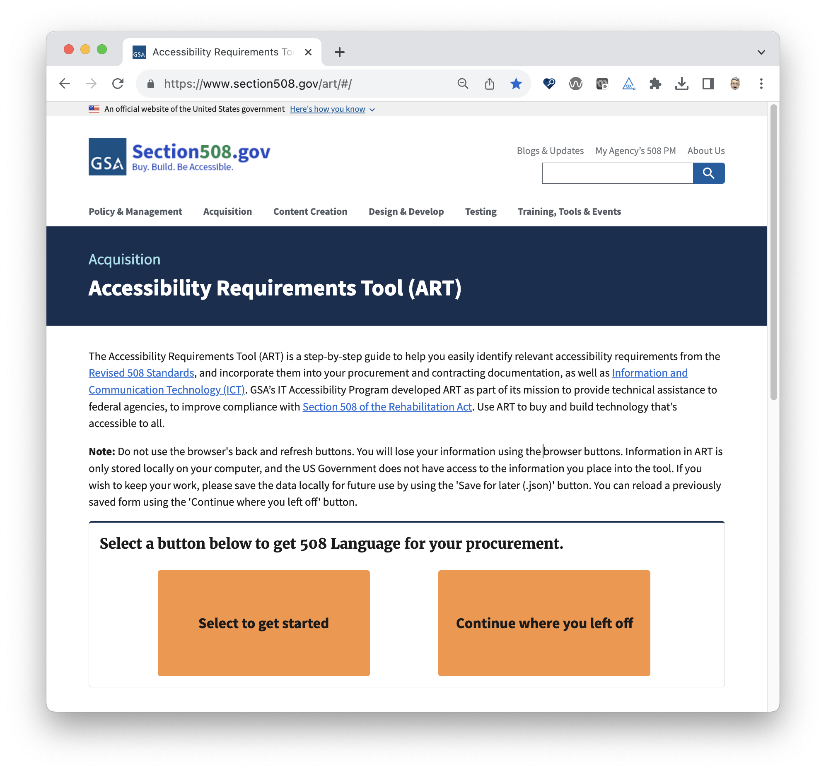
What is ART?
ART stands for:
Accessibility
Requirements
Tool
ART’s Role in the Acquisition Process
Notes:
SPEAKER: What is ART?
The acronym stands for Accessibility Requirements Tool. ART is a multifaceted, step-by-step tool that offers interactive, step-by-step guidance on how to determine applicable accessibility requirements to then incorporate in your procurement documents, and be used for all in-house IT development.
A few of the goals for this tool when it was developed were to
Assist with ensuring information communication technology (ICT) purchases are accessible from the start by providing an easy step by step tool to develop Section 508 requirements
This tool also provides the necessary technical criteria in an exportable report format word docx
The ability to save progress mid-review, and continue the review later by uploading the saved, json file that allows you to return to the tool where you left off
ART’s Role in the acquisition process
Provide accurate section 508 requirements for the user to be included in their solicitation
Reduce remediation, modification and lawsuits
Provide a standardized option for agencies to ensure everyone is generated the section 508 requirements

Slide 8
ART Enhancements
Reduced time to complete a procurement flow by 50%
Modernized from Drupal7 to the the latest framework, Angular15
ART can be launched from Section508.gov which uses Cloud.gov Pages
Open source on GitHub
Ability to save a completed form in multiple formats
Comprehensive data dictionary of Section 508 requirements for each category
Multiple options to download procurement document
Option to continue where user left off via JSON upload
Mobile launch
Ability to be integrated with other platforms and software
Notes:
SPEAKER: Some of the enhancements include…
Next Slide

Slide 9

ART Demo
Section508.gov/art
Notes:
SPEAKER:
I will demonstrate three different ICT scenarios and how to use ART for each scenario.
Scenario 1: Adobe Visual Studio (software and also electronic content)
Scenario 2: Kiosk (Hardware and includes software that does not need internet access)
Scenario 3: Server (Hardware that requires physical installation)

Slide 10
Incorporating Feedback
Continuously improving ART post launch:
Demos to over 1,400 federal employees across 13 agencies
Conducted User Acceptance Testing and have incorporated user requests, feedback, and corrections into ART
Implementation of user requests to make ART user friendly, useful, and meaningful to generate Section 508 language
Developing an Application Programming Interface (API) for ART to integrate with other systems and provide Section 508 language
Piloting with the Solicitations Review Tool (SRT) to go live July 2024
To share your feedback, email us at art@gsa.gov

Slide 11
Questions?

Slide 12
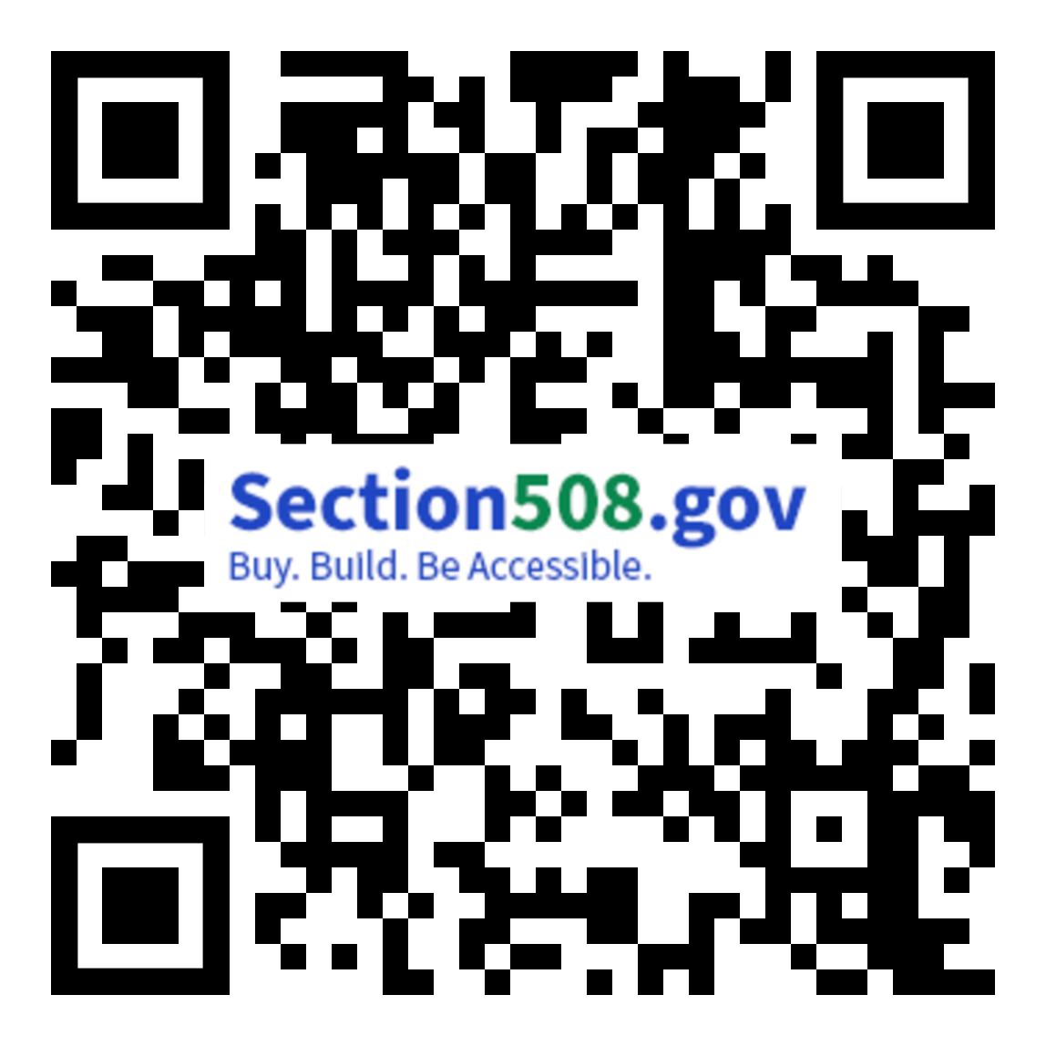
CSUN Sessions and Presentation Files
FED Talk - Section 508 Activities Update by USAB & GSA Tuesday at 10:20 a.m. in Grand GH
Section 508 ICT Testing Baseline Portfolio Wednesday at 10:20 a.m. in Grand GH
OpenACR: The Future of Accessibility Conformance Reporting Wednesday at 11:20 a.m. in Grand GH
Birds of a Feather Thursday at 12:00 p.m. in Platinum 9-10 Ballroom
Analytical Approach to the Governmentwide Annual Assessment Thursday at 3:20 p.m. in Orange County 1-2
Introduction to the Accessibility Requirements Tool (ART) Thursday at 4:20 p.m. in Grand JK
Section508.gov/csun2024/

